Slide 1

South Region
Second Edition
Gas Regional Investment Plan
SGRI – 13 December 2013

Slide 2
Table of content
  Perimeter / objectives
  Planning
  Consultation
  GRIP Workshop feedback
2

Slide 3
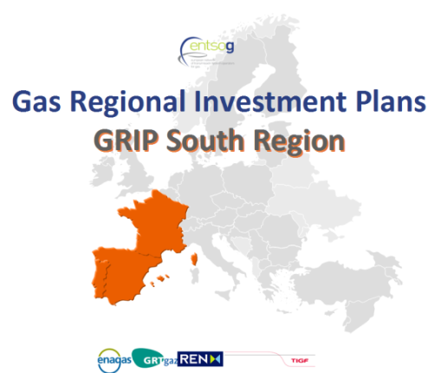
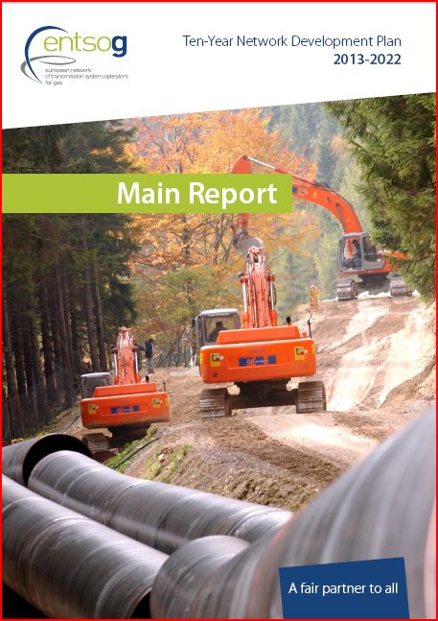
Perimeter /Objectives
3 Countries (FR, SP, PT) and 4 TSOs
Main drivers/objectives
Complementing the EU-TYNDP 2013
Feedbacks received:
  updated information / TYNDP
  More harmonization (with ENTSOG assistance)
  More communication/consultation
  More comprehensive approach on the system needs and on remedies (projects)
EU energy policy, “Trans-European energy infrastructure” (17/04/13)
“The strategic concept of the North-South Corridor in Western Europe, that is to better interconnect the Mediterranean area and thus supplies from Africa and the Northern supply Corridor with supplies from Norway and Russia.” (EC, EIP for 2020)

Slide 4
Planning
  ENTSOG TYNDP publication : 21st February 2013
  Communication / consultation
    Continuous and extensive consultation for identifying and updating projects and needs
    GRI South meeting(s): IG & SG meetings (5)
    ENTSOG WS : 26th November → Consultation document
    Regulators: “Draft GRIP”
    Feedbacks after publication
  “Draft GRIP” beginning of December
    to finalize with last results/verifications
    + last feedbacks to introduce
  Publication : January/February 2014
4

Slide 5
GRIP South – Consultation 1/4
All feedbacks are welcome. Questions are proposed below.
Answers to send to Nathalie.cale@GRTgaz.com by 05/01/2014.
Organisation and contact details:
Company/Organisation Name:
Contact person:
E-mail:
Question 1: Do you consider useful the analysis developed in the Supply & Demand chapters? Would you like to see included additional information/analysis in these chapters?
5

Slide 6
GRIP South – Consultation 2/4
Question 2: This GRIP incorporates updated information on infrastructure projects from TSO and third party projects. Do you consider it useful? What other information would you like to see?
Question 3: This GRIP has completed an in-depth analysis of the gas system assessments realized in the ENTSOG TYNDP 2013-2022. Do you think it’s useful? Do you think more sensitivity studies should be developed?
6

Slide 7
GRIP South – Consultation 3/4
Question 4: Are the additional assessments/analysis/information interesting and useful for better understanding of the gas network system needs? Are there any other analysis not addressed in the GRIP that should be included?
Question 5: Do you think that a good level of market integration could be achieved into the Region and with the rest of Europe with the implementation of the projects answering to the needs identified in this GRIP?
7

Slide 8
GRIP South – Consultation 4/4
Question 6: More generally, do you agree on the key results obtained in the GRIP?
Question 7: Which chapter, do you think, will be more useful/interesting and why?
Question 8: Do you have any further comments?
8

Slide 9
GRIP Workshop 26 November – Feedback
Presentation of the GRIP South : perimeter/objectives, detailed content, planning and consultation process
General positive assessment from the attending stakeholders
One question from the French NRA about the use of modeling in the studies
GRIP South answered :
  in addition to the TYNDP’s simulations, complimentary calculations were used in the current draft version.
  using NeMo tool, sensibility simulations have been developed for the GRIP South with and without some relevant projects in the Region.
  As the update of demand and projects shows no significant changes resulting in a comparable scenario for the year horizon, the pillar results obtained in the TYNDP related to the Region are valid and robust.
  The main simulations cases are being checked at ENTSOG level. The final GRIP South report will be tested/updated accordingly if necessary.
9

Slide 10
Thank you for your attention

